Slide 1
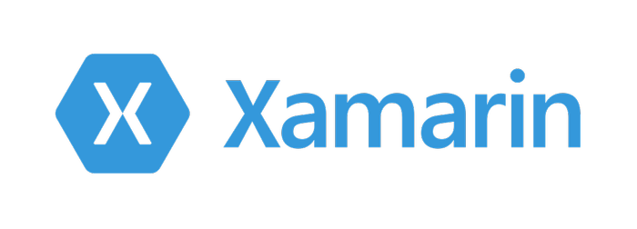

Slide 2
What is Xamarin?
Mobile Apps
Build native apps with .NET and C#
Cross-Platform
Android, iOS, Windows
Tooling
Develop with Windows or Mac
Ecosystem
Xamarin Forms
Xamarin Essentials

Slide 3
Heritage and Philosophy

Slide 4
Development Platforms
Xamarin Forms
XAML – Visual Appearance
Code-behind – Behaviour
Shared across platforms
Code reuse
Architecture
Xamarin
Tooling
Windows 10
Android
Windows
Mac
Android
iOS

Slide 5
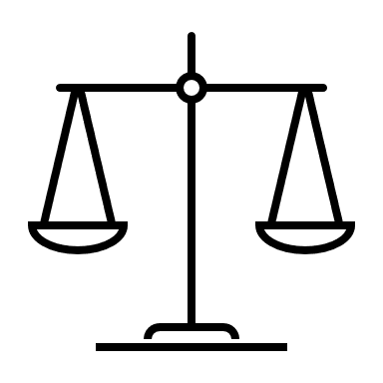
Strengths and Weaknesses

Slide 6



Strengths
Shared Application Logic
Benefits of C#
Basic Knowledge of native languages required ex. Java and Swift
Notes:
Shared App Logic: Apart from a native user interface, the ease of sharing the app code to multiple mobile platforms makes Xamarin the must-use cross-platform mobile development tool. The app logic underlying the UI layer that consists of input validation, database interactions, web service calls, and back-end enterprise integrations are coded with C#.
Benefits of C#: C# is a sophisticated, general-purpose, and type-safe programming language, mainly for Windows platform. It is object-oriented and a rather modernized version of C++. It enables even the basic data types to be treated as objects. C#’s type-safety feature lets you prevent type errors that can result in erroneous program behavior, without having to use boilerplate or verbose type annotations
API Integration: Xamarin allows developers to combine the same APIs and UI controls that are used for developing Android, iOS and Mac application in their respective platform-specific programming languages (Java, Swift, and Objective-C). Its unique binding approach facilitates support for new features right after they are introduced into a device’s operating system.

Slide 7
Weaknesses
Small Community
Delayed Support for Latest Updates
Basic Knowledge of native languages required ex. Java and Swift
Not suitable for heavy graphics
Large file size

Slide 8
Model View View-Model
Model
Business Logic
C# classes
View
User Interface
How to display the Informaiton?
View-Model
What is going to be displayed?
Flow of interaction from the user
Architecture Pattern

Slide 9
MVVM Framework == Data Binding

